Slide 1
Practice :
Integration by Partial Fractions

Slide 2
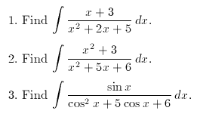

Slide 3
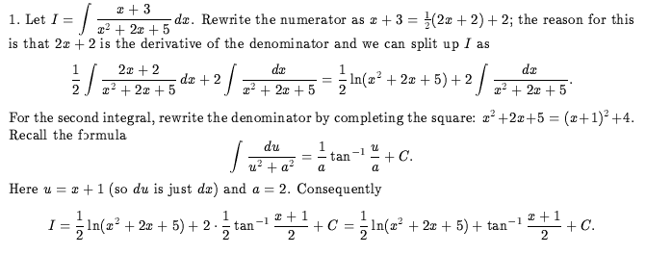
Answers:

Slide 4
